Slide 1
Global Economic and Demographic Trends Analysis
Name
Batch
: Moviraj d
: Da-ds may[rp-36]

Slide 2
Introduction
Analyze global population, GDP, literacy & health indicators
Identify trends, disparities, and correlations
Deliver insights via interactive Power BI dashboard

Slide 3
Dataset Overview
CountriesWorld (SQL): GDP, Literacy, Infant Mortality, Demographics
PopulationPerCountry (Excel): Population 1960–2017
GDP by Country (Excel): GDP 1960–2016
MetaData (Excel): Region & Income Groups

Slide 4
Data Cleaning & Transformation
Handled missing values & duplicates
Standardized country codes/names
Converted time-series into yearly records
Built relationships using Country Code

Slide 5
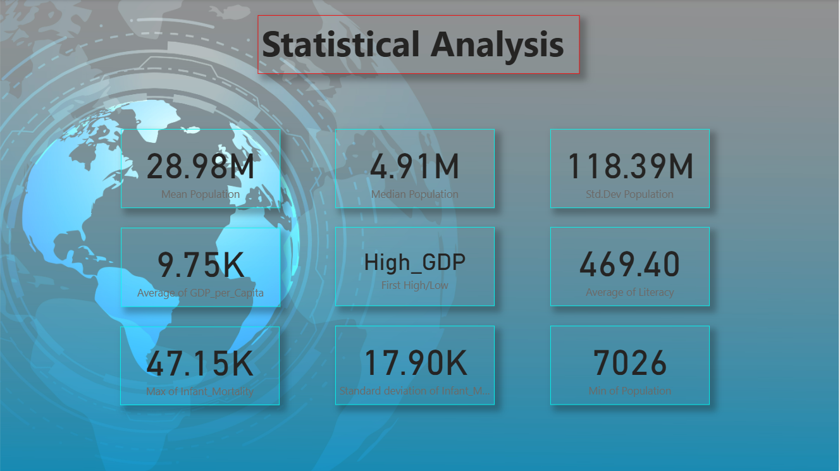
Statistics aNALYSIS
Population: Mean, Median, Std Dev
GDP: Avg GDP per capita, Highest & Lowest GDP
Infant Mortality: Min, Max, Range, Std Dev
Literacy: Average rates by country & region

Slide 6
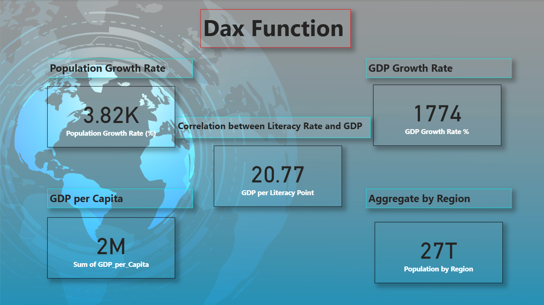
DAX fUNCTIONS
Population Growth Rate (%)
GDP Growth Rate (%)
GDP per Capita (calculated column)
Population & GDP aggregated by Region
Literacy ↔ GDP correlation

Slide 7
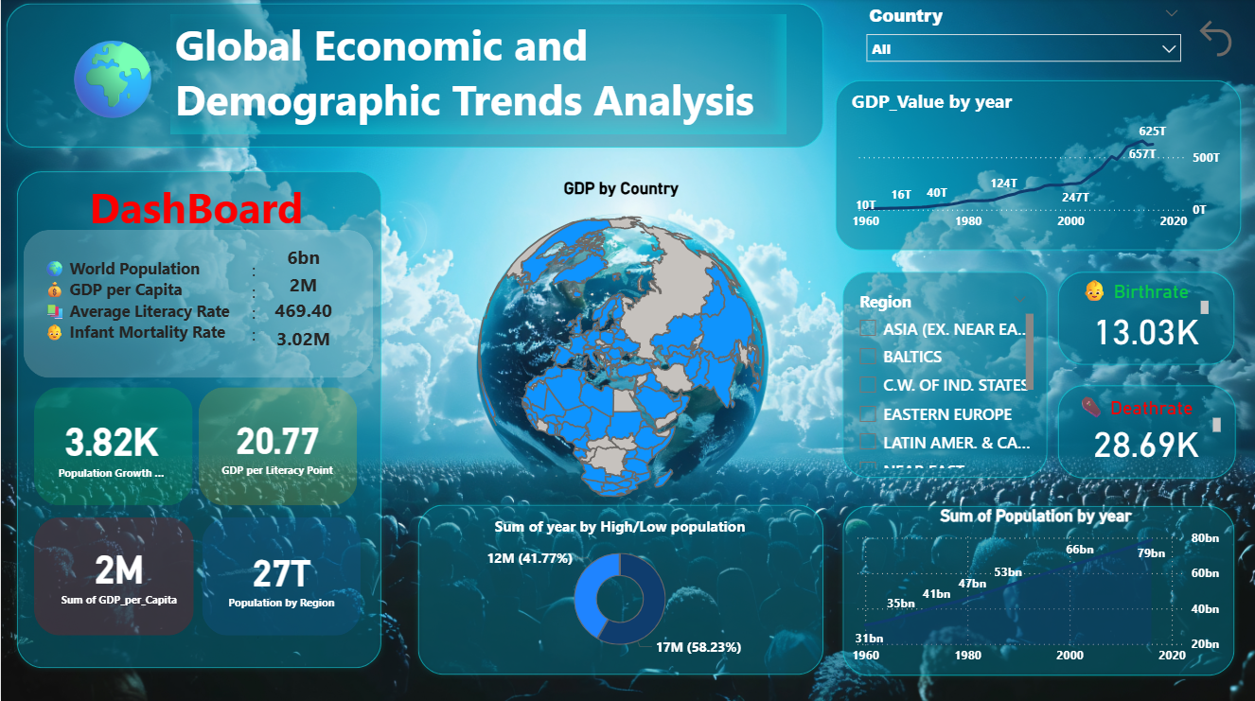
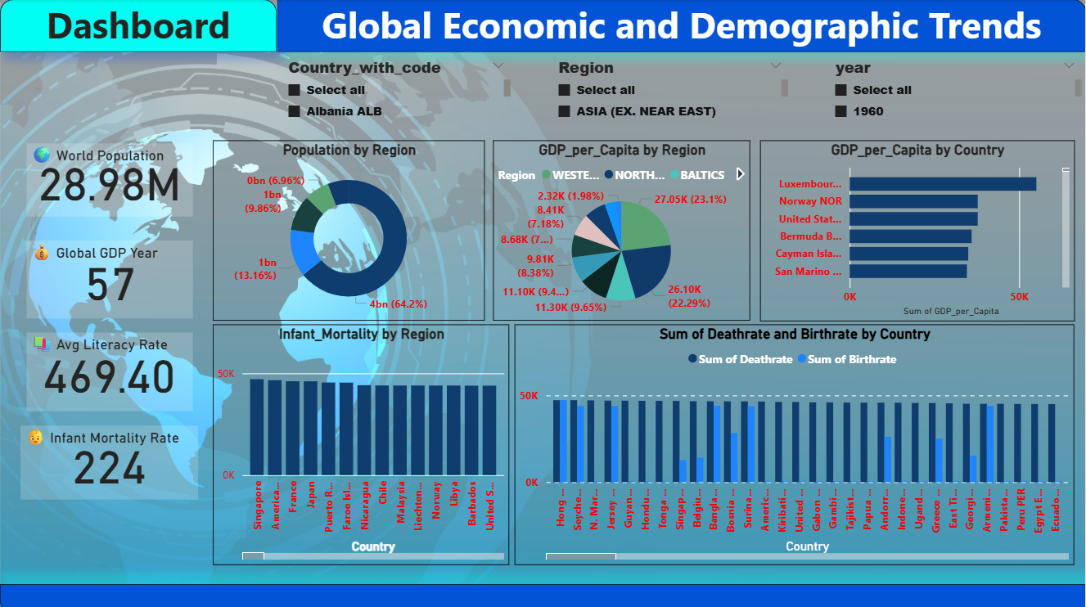
Dashboard
KPI Cards: Population | GDP | Literacy | Mortality
Maps: Population & GDP per capita distribution
Line Charts: Growth trends (1960–2017)
Bar Charts: Literacy & GDP by Region

Slide 8
Key Insights
Developing regions → High population, Low GDP per capita
Literacy ↔ Higher GDP correlation
Infant mortality ↓ globally but high in low-income areas
Asia & Africa drive most global population growth
Recommendations
Invest in Education to boost GDP
Strengthen Healthcare to cut infant mortality
Promote Sustainable & Inclusive Growth

Slide 9
Conclusion
Population doubled since 1960 → uneven progress
Education & healthcare = key drivers of prosperity
Inclusive policies needed to reduce disparities
Long-term focus on human capital & sustainability

Slide 10
THANK YOU

